Slide 1
VALUES

Slide 2
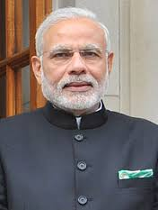
Do you know this person?

Slide 3
Yes, you are right.
He is Mr. Narendra Modi, the Prime Minister of India

Slide 4
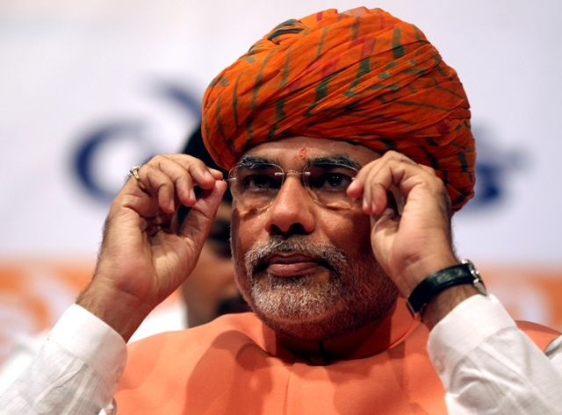
Who Is he?

Slide 5
Absolutely right..
He is Narendra Modi, when he was the Chief Minister of Gujarat from 2001- 2014

Slide 6
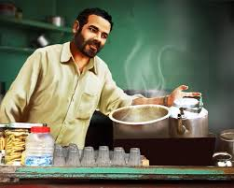
Can you guess now who is he ?

Slide 7
Well done! He is again Narendra Modi,
When he used to sell tea in Gujarat

Slide 8

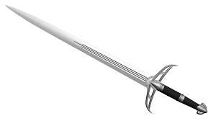
We recognise many things by face like
This is called the Face Value.

Slide 9
Same way Narendra Modi’s face is his
Face Value

Slide 10
P.M., C. M. or Tea seller denote his position or place. So it is called the Place value.

Slide 11
What have you learnt from this?

Slide 12
We have seen that the face value remains the same but the place value changes

Slide 13
Numbers too have the same property

Slide 14
7
What number is this?

Slide 15
Yes it is seven.
7 is its face value.

Slide 16
What do you think is the place value of numbers?

Slide 17
Place value means value of a place. It tells us the value of each digit in a numeral based on its position or place.

Slide 18
A place value chart helps us to recognize large numbers.
Crores |  | Lakhs |  | Thousands |  | Ones
Ten Crores (TC) (10,00,00,000) | Crores (C) (1,00,00,000) | Ten Lakhs (TL) (10,00,000) | Lakhs (L) (1,00,000) | Ten Thousands (TTh) (10,000) | Thousands (Th) (1000) | Hundreds (H) (100) | Tens (T) (10) | Ones (O) (1)

Slide 19
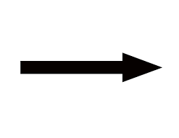
We read place value chart from left to right.
Crores |  | Lakhs |  | Thousands |  | Ones
Ten Crores (TC) (10,00,00,000) | Crores (C) (1,00,00,000) | Ten Lakhs (TL) (10,00,000) | Lakhs (L) (1,00,000) | Ten Thousands (TTh) (10,000) | Thousands (Th) (1000) | Hundreds (H) (100) | Tens (T) (10) | Ones (O) (1)
19

Slide 20
. In Indian system we start grouping the number from right in group of 3 and further in group of 2.
Crores |  | Lakhs |  | Thousands |  | Ones
Ten Crores (TC) (10,00,00,000) | Crores (C) (1,00,00,000) | Ten Lakhs (TL) (10,00,000) | Lakhs (L) (1,00,000) | Ten Thousands (TTh) (10,000) | Thousands (Th) (1000) | Hundreds (H) (100) | Tens (T) (10) | Ones (O) (1)

Slide 21
Crores |  | Lakhs |  | Thousands |  | Ones
Ten Crores 2 | Crores 6 | Ten Lakhs 9 | Lakhs 5 | Ten Thousands 8 | Thousands 4 | Hundreds 3 | Tens 1 | Ones 7
Lets read this number

Slide 22
2073
What is the place value of seven here

Slide 23
You are right, it is at tens’ place
So its place value is 7 tens or 70

Slide 24
Find the place value of 7 in-1,78,031

Slide 25
Did you say Ten thousand ?
1,78,031

Slide 26
Great ! Yes, It is 7 Ten thousand or
70,000

Slide 27
What does it prove ?

Slide 28
It proves that the Face Value always remains the same but the Place Value can be changed

Slide 29
Now tell me what do you say about this number-
77,777
What is the face value and the place value of 7 here?

Slide 30
Wow ! You are right. The face value of 7 is 7 only . But what about the Place value?

Slide 31
Do you remember we have just learnt that every place has its own place value? So 7 in this case has different place value at each place.

Slide 32
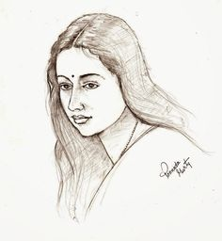
Just like Anu’s mom.
She is Anu’s mom,
Anil Joshi’s wife,
Mr Verma’s daughter and
Anu’s uncle’s sister.
Meet Mrs. Malti Joshi.

Slide 33
Her Face value remains the same but her position or place value
is different at the same time.

Slide 34
Numbers too, at times, behave like human beings.

Slide 35
It proves that all the things big or small, ugly or beautiful have a face value. They might have the same or different place value.

Slide 36
Every place has its own value. No one can reach the highest place without stepping on the lowest place.

Slide 37
Every place has its own power and responsibilities. We should not look down upon any one or any thing as no one knows when the place value changes.
Remember the tea seller of Gujarat?

Slide 38
THANK YOU
Rekha Anand

